Slide 2


Slide 3
Lessons From the Prophet Isaiah
“REFOCUSING OUR WORSHIP”
Isaiah 66:18-21

Slide 4
“In the year that King Uzziah died, I saw the Lord seated on a throne, high and exalted, and the train of his robe filled the temple.” Isaiah 6:1 (NIV)

Slide 5
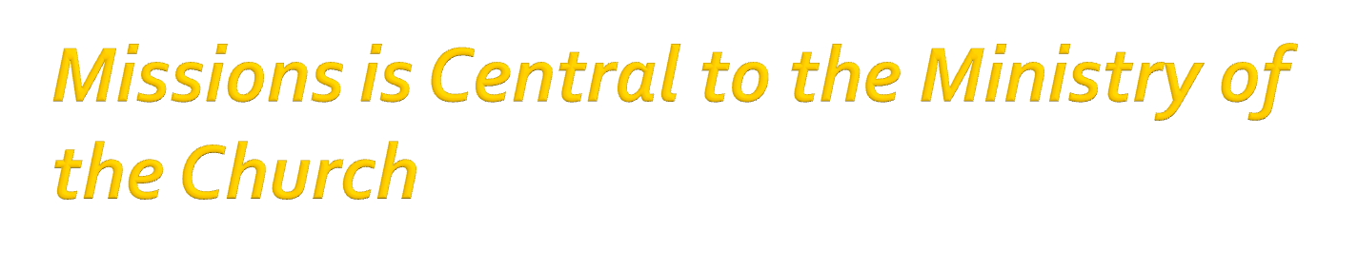

Slide 6
The Church exists to EXALT God, EDIFY one another, and EXTEND God’s love to all People.

Slide 7

“I… am about to come and gather all nations and tongues, and they will come and see my glory”
(Isaiah 66:18).

Slide 8

“Now we see but a poor reflection as in a mirror; then we shall see face to face”
(1 Corinthians 13:12).

Slide 9

“The god of this age has blinded the minds of unbelievers, so that they cannot see the light of the gospel of the glory of Christ, who is the image of God”
(2 Corinthians 4:4).

Slide 10

“And we, who with unveiled faces all reflect [behold] the Lord's glory, are being transformed into his likeness” (2 Corinthians 3:18).

Slide 11

Out of this community of people who see Christ’s glory, come commissioned people who proclaim His glory. When God restores worship, His people pursue mission.

